Slide 1
DRIVER DROWSINESS
MONITORING SYSTEM –UsingOpenCV
Done by:-
# Vishnu Prakash L
# Thiviyanath G
# Vishal Rajashekar

Slide 2
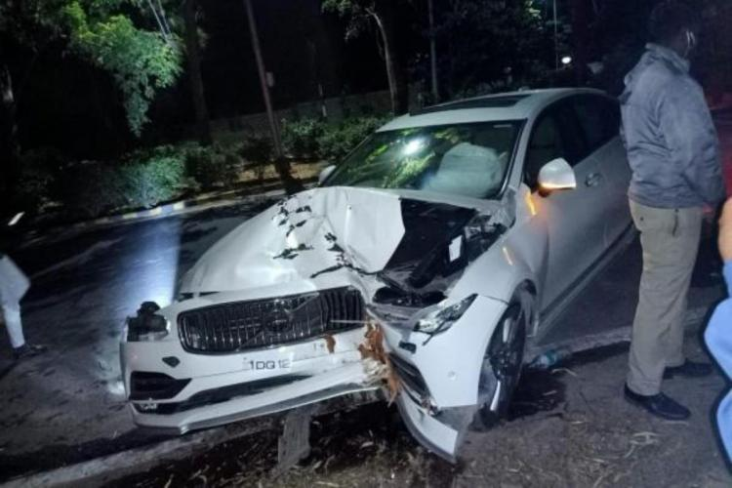
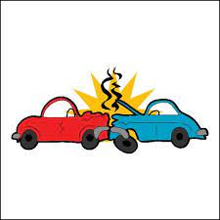
OBJECTIVE:-
Nowadays the driver safety in the car is one of the most wanted system to avoid accidents. Our objective of the project is to ensure the safety system. For enhancing the safety, we are detecting the eye blinks of the driver and estimating the driver status and warn the driver with a alarm sound.

Slide 3
ABSTRACT:-
Drowsiness detection is a safety technology that can prevent accidents that are caused by drivers who fell asleep while driving.
The objective of this intermediate Python project is to build a drowsiness detection system that will detect that a person’s eyes are closed for a few seconds. This system will alert the driver when drowsiness is detected with a alarm(beep) sound.
Drowsy Driver Detection System has been developed using a non-intrusive machine vision based concepts.

Slide 4
SOFTWARE & HARDWARE REQUIREMENTS:-
The requirement for this Python project is a webcam through which we will capture images. You need to have Python (3.6 version recommended) installed on your system, then using pip, you can install the necessary packages.
OpenCV – pip install opencv-python
Tkinter – pip install tkinter
Numpy – pip install numpy
Pygame – pip install pygame
All this modules installed in a Laptop with proper working webcam and speakers.

Slide 5
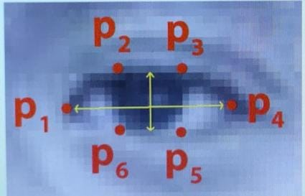
WORKING OF SYSTEM:

Slide 6
IMPLEMENTATION ON CAR:-
This project can be integrated with car, so that automatic speed control can be imparted if the driver is found sleeping.
This project can also be implemented in the form of mobile application to reduce the cost of hardware.

Slide 7
ADVANTAGE:
Security of vechicle .
Record driving data, collision data and position of data.
Analyze the accident details.
Detect if the driver is feeling sleepy.

Slide 8
DISADVANTAGE:
Highly dependent on the lighting and quality of the camera used.
System will malfunction when multiple faces are detected.
Position of the camera plays a key role.

Slide 9
FUTURE SCOPE:
This project can be implemented in the form of mobile application to reduce the cost of hardware.
2. This project can be integrated with car, so that automatic speed control can be imparted if the driver is found sleeping

Slide 10
CONCLUSION:
We conclude that by designing a hybrid drowsiness detection system that combines non-intusive physiological measures with other measures one would accurately determine the drowsiness level of a driver. A number of road accidents might then be avoided if an alert is sent to a driver that is deemed drowsy.

Slide 11
THANK YOU

